Slide 1
Microplastics Removal Strategies in Drinking Water and Wastewater Treatment Plants
Student Investigators: Summer Siddiqui, and Sofia Radulovic
Faculty Supervisor: Professor Massoud Pirbazari

Slide 2
Table of Contents
Case 1: Treatment of Microplastics in Czech Republic… 13
Water Sources, Filtration Methods, Experimentation, and Results
Case 2: Treatment of Microplastics at Drinking Water Treatment Plants… 15
Treatment Method and Results for DWTP Plzen
Treatment Method and Results for DWTP Milence
Removal of Microplastics in Wastewater Treatment Plants… 19
Summary & Discussion… 21
Recommendation for Future Research… 22
References… 23
Acknowledgements… 27
Rationale… 3
Worldwide Production of Plastics… 4
Health Impacts of Microplastics on People and Animals… 5
Removal of Microplastics in Water Treatment by Oxidation… 6
Ozone Treatment
UV Photolysis
Heat-Activated Persulfate Treatment
UV Photocatalysis
Fenton Process
Photo-Fenton Process
2

Slide 3
Rationale
Microplastic particles have proven to be harmful for plants, animals , humans, and in general, for terrestrial and aquatic ecosystems.
Water is one of the most important routes which microplastics transfer from one location to another.
Microplastics may enter drinking water sources:
from surface run-off
from wastewater effluent, iii) from industrial effluent, and iv) by air deposition.
The surface of microplastic particles may carry disease-causing microorganisms such as viruses, as vector for a number of diseases.
3

Slide 4
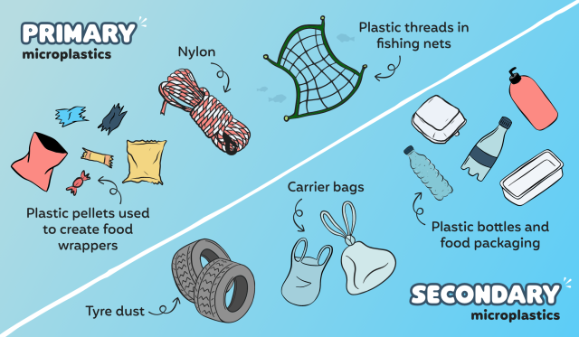
Worldwide Production of Plastics
Microplastics are small pieces of plastic debris in the environment that cannot break down on their own.
They can be an outcome of a variety of sources, including daily human activities as simple as laundry processes.
There are two categories of microplastics: primary and secondary plastics.
Primary microplastics are particles that come from manufactured products such as clothes, soap, toothpaste and other textiles.
Secondary microplastics result from fragmentation of larger plastics items such as grocery bags and water bottles.
4

Slide 5
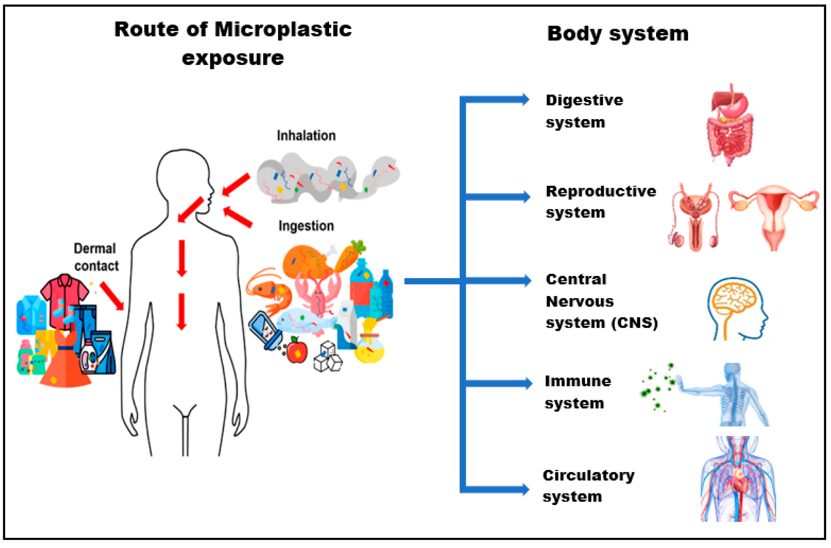
Health Impacts of Microplastics on People and Animals
Microplastics can mix with other harmful metals, chemicals, and drugs that when consumed can cause hazardous respiratory issues in both people and animals.
For many organisms, consumed microplastics can block gastrointestinal pathways, tricking the animal into thinking they’re full, causing them to starve.
For people, the ingestion of these dangerous substances can also lead to issues with the endocrine system, reproductive system, and immune response system.
5

Slide 6
Removal of Microplastics
in Water Treatment by
Oxidation
6

Slide 7
Ozone Treatment
Ozone treatment is extremely effective at removing microplastics. In a comparison of three wastewater treatment plants attempting to remove the microplastics, the one treated with ozone technology reduced the microplastics by 89.9% and had the lowest number of microplastics in the effluent.
Ozone treatment was found to increase surface tension, hydrophilicity, adhesion, and solubility. It also reduced the melting point, and decreased the intrinsic viscosity.
7

Slide 8
UV Photolysis
UV Photolysis had a more negative affect on microplastics. After being treated with UV, microplastics in the environment are able to cause oxidative degradation, leading to photoaging. Photoaging significantly changes the behavior of the microplastics, and can pose a much greater risk to the environment.
8

Slide 9
Heat-Activated Persulfate Treatment
Heat-activated Persulfate treatment uses potassium persulfate to achieve a high level of oxidation in order to degrade microplastics. In this process, heat is used to activate the persulfate to create hydroxyl and sulfate radicals, which help the surface oxidation of microplastics.
9

Slide 10
UV Photocatalysis
Using a titanium dioxide membrane under UV light is effective in breaking down microplastics, such as polystyrene and polyethylene. Some benefits are that the primary product is carbon dioxide, the method is not expensive, and it includes no hazardous or toxic chemicals. However, limitations are that it only occurs under UV light, meaning it does not occur in water.
10

Slide 11
Fenton Process
Adding Fenton reagents and permonosulfate in a water and hydrogen peroxide solution, causes an effective breakdown of microplastics. Conveniently, this method is also not expensive, includes no hazardous chemicals, and the resulting organic carbon can be used by other organisms.
11

Slide 12
Photo-Fenton Process
The Photo-Fenton process is very similar to the original Fenton process, however the reaction occurs under UV light. This method is able to speed up the process, while stabilizing the iron. It also allows the Fenton to work at a wider pH range.
12

Slide 13
Case 1: Treatment of Microplastics in Czech Republic
Water Sources, Filtration Methods, Experimentation, and Results:
There are three water treatment plants that act as sources of water. The first is a large valley reservoir, the second is a small water reservoir, and the third is a river that feeds into the three water treatment plants.
Sources of microplastics for these water treatment plants include sewage discharge, plastic manufacturing, and plastic decomposing. The three filtration methods used for the water treatment plants includes sand filtration only, a combination of sedimentation and sand flux, and a combination of flotation and sand filtration.
13

Slide 14
Case 1 (continued):
The methods of experiment incorporate the use of scanning electron microscopy to measure the particles, removal of organic materials from samples, glass vacuum filtration to remove any unwanted substances, and before imaging researchers put a conductive gold layer onto the sample. Results showed that 10 micrometers of microplastics were found in both raw and treated waters.
14

Slide 15
Background:
Case 2: Treatment of Microplastics at Drinking Water Treatment Plants (DWTPs) Plzen and Milence in the Czech Republic
There are two drinking water plants , namely Milence and Plzen, that monitor the removal of microplastics. The maximum capacity of Milence and Plzen are 180 to 400 l/sec and 400 to 1000 l/sec, respectively. Plzen DWTP is located in upstream of Ulava River and Milence DWTP is downstream of Ulava River.
15

Slide 16
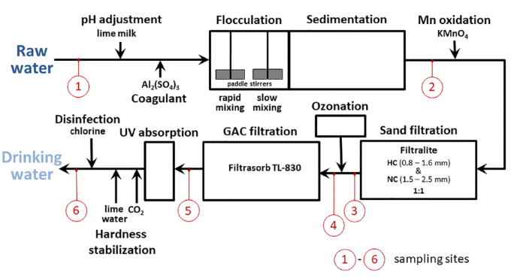
Treatment Method and Results for DWTP Plzen
Case 2 (continued):
The treatment process of DWTP Plzen consists of coagulation/ flocculation/ sedimentation/ filtration/ ozonation, and GAC filtration.
Water samples were taken at 6 different sites (see figure at right).
The overall percentage removal efficiency was approximately 83 to 84.
16
13

Slide 17
Treatment Method and Results for DWTP Plzen
Case 2 (continued):
Treatment Results:
Concentrations of microplastics at each stage of treatment are depicted below:
Site 1- Raw water: 1296 +/- 35 MPs /l
Site 2- After coagulation-flocculation-sedimentation, the number decreased to 497+/- MPs /l
Site 3- Subsequent filtration reduced the number to 243 +/- 17 MPs/l
Site 4- Subsequent ozonation had insignificant effect reduced the number to 224+/- 3 MPs/l
Site 5- GAC reduced the number to 149 +/- 1 MPs/l
Site 6- Treated water had 151 +/- 4MPs/l
17

Slide 18
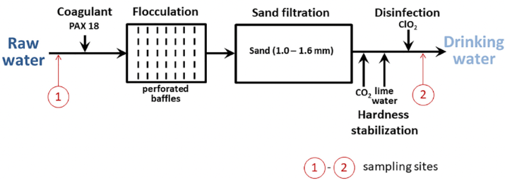
Treatment Method and Results for DWTP Milence
Case 2 (continued):
In the Milence drinking water treatment plant, shown on right, samples were only taken at the plant’s influent and effluent points. Results showed that raw water had on the average 23±2 microplastics per liter, while treated water had 14±1 microplastics per liter.
18
13

Slide 19
Removal of Microplastics in Wastewater Treatment Plants
Wastewater treatment plants are large sources of microplastics, as they tend to receive terrestrial microplastics before they enter the environment. In “A Review of the Removal of Microplastics in Global Wastewater Treatment Plants”, quantitative analysis was used to compare removal efficiency of microplastics in different treatment methods within several wastewater treatment plants.
19

Slide 20
Removal of Microplastics in Wastewater Treatment Plants (continued)
There are large quantities of microplastics found in the influent, as well as in the primary, secondary, and tertiary treatment processes. However, data in a wastewater treatment plant in the UK showed that these microplastic quantities were reduced up to 96%. It was also found that mechanical, chemical, and biological treatments could reduce up to 99% of microplastics in this treatment plant. It is important to note that different wastewater treatment plants show different effectiveness levels. This poses a great challenge, as certain treatments may not be as functional in different wastewater treatment plants. This shows the necessity of further method development in order for microplastic removal to be as equally successful in many places.
20

Slide 21
Summary and Discussion:
Removal Technologies of Microplastics in Drinking Water and Wastewater Plants
Removal of Microplastics in Drinking Water Plants (DWTPs)
Coagulation, flocculation, sedimentation, and filtration processes are in general, efficient.
Advanced oxidation processes demonstrate high removal efficiencies
Removal of Microplastics in Wastewater Treatment Plants (WWTPs)
Primary treatment and secondary treatment are the main processes to remove microplastics.
Membrane bioreactor (MBR) has higher removal efficiency than conventional activated sludge (CAS) treatment.
21

Slide 22
Recommendation for Future Research
When considering removal technologies, pilot-plant investigations need to be conducted for each different case.
It is important to keep in mind that removal efficiencies of MPs vary significantly in different DWTPs and WWTPs
22

Slide 23
References
Chen, Zhijie, et al., “Nanoplastics are Significantly Different from Microplastics in Urban Waters.” Water Research X, (2023), 100169.
Conley, Kenda, et al. “Wastewater Treatment Plants as a Source of Microplastics to an Urban Estuary: Removal Efficiencies and Loading per Capita over One Year.” Water Research X, vol. 3, 2019, p. 100030.
Ding, S., Sin, A. , Nam, H., Park, Y., Lee, H. , Han, C., “Advanced oxidation processes for microplastic degradation: recent trend”, Chemical Engineering Journal Advances (2022), 9, 100213.
Fadli, M. H., Ibadurrhmass,M., Salinat, S., “Microplastic pollutant degradation in water using modified TiO2photocatalysis under UV irradiation”, IOP Conference Ser. Material Sci. Eng. (2021), 012055.
Hidayaturrahman, H. , Lee, T. G., “A study of microplastic in wastewater of South Korea: identification, quantification, and fate of micropollutants during treatment process”, Mar. Pollut. Bull. 146 (2019) 696-702.
Jiang, Q, Li, Z., Wei, R., Xu, H., Liu, L. “Quantum mechanical investigation of the oxidative cleavage of c-c backbone bonds in polyethylene model molecule”, Polymers, (2021), 13 (16), 2730.
23

Slide 24
References
Kida, M., Ziembowicz, et al., “Impact of modified Fenton process on the degradation of a component leached from microplastics in bottom sediments”, Catalysis, (2019), 9(11), 932.
Kim, S., Sim, A., Nam, H. Park, Y., Lee, H. Han, C., “Advanced oxidation processes for microplastics degradation: A recent trend”, Chemical Engineering Journal Advances, (2022), 9, 100213.
Liu, Jiang, Q., Qui, z., Liu, L., Wei, R., Zhang, x., Process analysis of microplastic degradation using activated PmS and Fenton Reagents:, Chemosphere, (2022), 298 134220.
Liu, Sun, P., Qu, G., Jing, J., Zhang, T., Shi, H., Zhao, Y.,” Insight into the characteristics and sorption behavior of aged polystyrene microplastics through three types of oxidation processes”, Journal of Hazardous Materials, (2021), 413, 124836.
Liu, Weiyi, et al., “A Review of Microplastics in Global Wastewater Treatment Plants: Characteristics and Mechanisms.” Environment International, vol. 146, (2021), 106277.
Luo, H., Zeng, Y., Zhao, Y., Xiang, Y., Li, Y., Pan, X., “Effect s of advanced oxidation processes on leachate and properties of microplastics”, Journal of Hazardous Materials, (2021), 407, 124836.
24

Slide 25
References
“Microplastics in Groundwater (and Our Drinking Water) Present Unknown Risk: Presentation at the 2020 Annual Meeting of the Geological Society of America.” ScienceDaily, www.sciencedaily.com/releases/2020/10/201026153939.htm. Accessed 17 July 2021.
Monkul MM, Özhan HO. Microplastic Contamination in Soils: A Review from Geotechnical Engineering View. Polymers (Basel), ( 2021), 13, (23), 4129.
Nabi, I., Li, K., Cheng, H., Wang, T., Liu, H., Ajmal, S., Yang, Y., Feng, Y., Zhang, L., “ Complete photocatalytic mineralization of microplastic on TiO2 nanoparticle film”, Science, (2020) 23, (7), 101326.
Pan, Yusheng, et al, "Removing Microplastics from Aquatic Environment- a Critical Review", Environmental science and Ecotechnology, (2023), 13, 100272.
Pivokonský, M. “Occurrence of Microplastics in Raw and Treated Drinking Water. | Semantic Scholar.” Occurrence of Microplastics in Raw and Treated Drinking Water., 2018.
Pivokonský, Martin, et al. “Occurrence and Fate of Microplastics at Two Different Drinking Water Treatment Plants within a River Catchment.” Science of The Total Environment, vol. 741, 2020, p. 140236.
25

Slide 26
References
Ricardo, I. A., Alberto, E. A., Silva Junor, A. H., Macuvele, D.L.P., Padoin, N., Soares, C., Riella, H. G., Starling,M. C., Troro, A. G., “ A critical review on microplastics , interaction with organic and inorganic pollutants, impacts and effectiveness of advanced oxidation processes applied for their removal from aqueous matrices”, Chemical Engineering Journal, (2021) 424, 130282
Shen, Maocai, et al. “Removal of microplastics via drinking water treatment: Current knowledge and Future Directions.” Chemosphere, vol. 251, (2020), 126612.
Surhoff, B. M., Scholz-Bottcher, B. M., “Qualitative impact of salinity , UV radiation of leaching of organic plastic additives from four common plastics - a lab experiment”, Mar. Pollut. Bull.,(2016), 102(1), 84-94
The Editors of Encyclopaedia Britannica. “Polyethylene.” Encyclopædia Britannica. Encyclopædia Britannica, inc., October 17, 2022. https://www.britannica.com/science/polyethylene.
Till, J., Abel de Souza Machado, A., Wai Lau, C., Kloas, W., Rillig, M. C., Lehmann, A., & Becker, R. (2018, July 27). Impacts of microplastics on the soil biophysical environment. ACS Publications.
Wang, J. C., Wang, H., Huang, L. I., Wang, C. Q., “ Surface treatment with Fenton for separation of acrylonitrile-butadiene-styrene and polyvinylchloride waste plastic by flotation”, Waste Management, (2017), 67, 20-26
26

Slide 27
Acknowledgement
We would like to express our appreciation to Emma Silverstein, and Ari Fischer for their able assistace in this research project.
27

