Slide 1
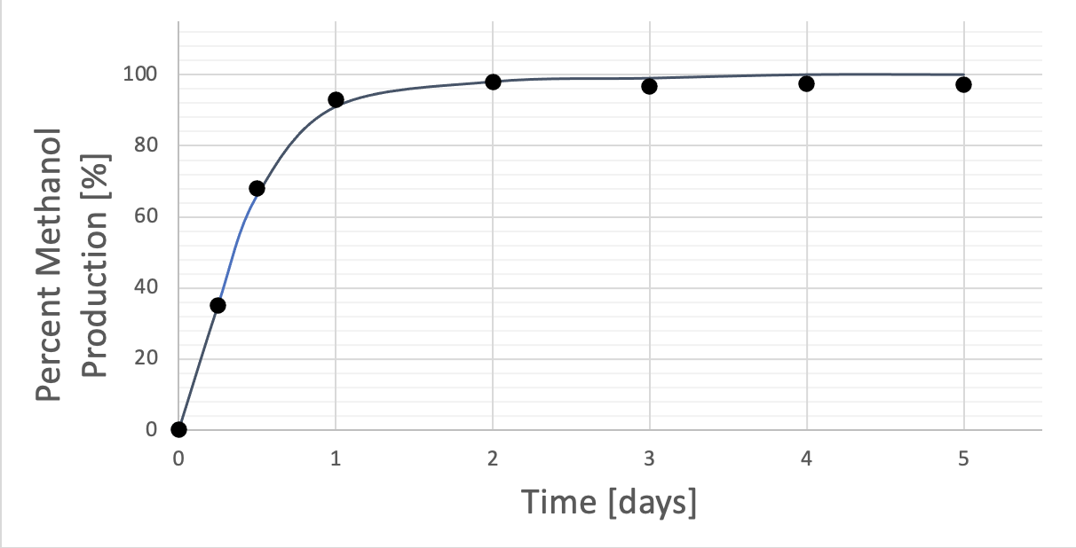
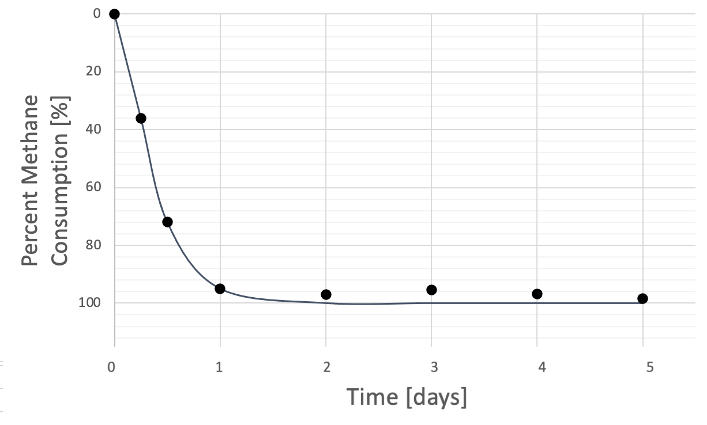
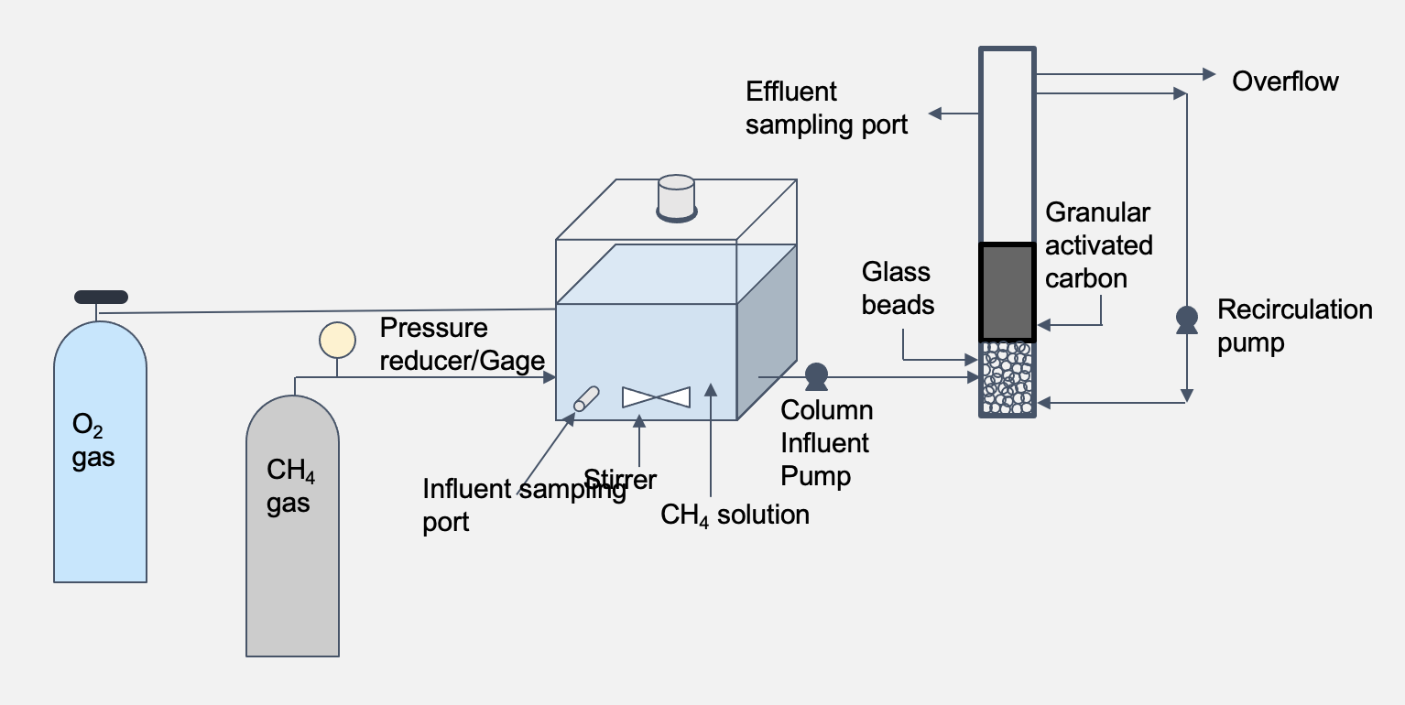
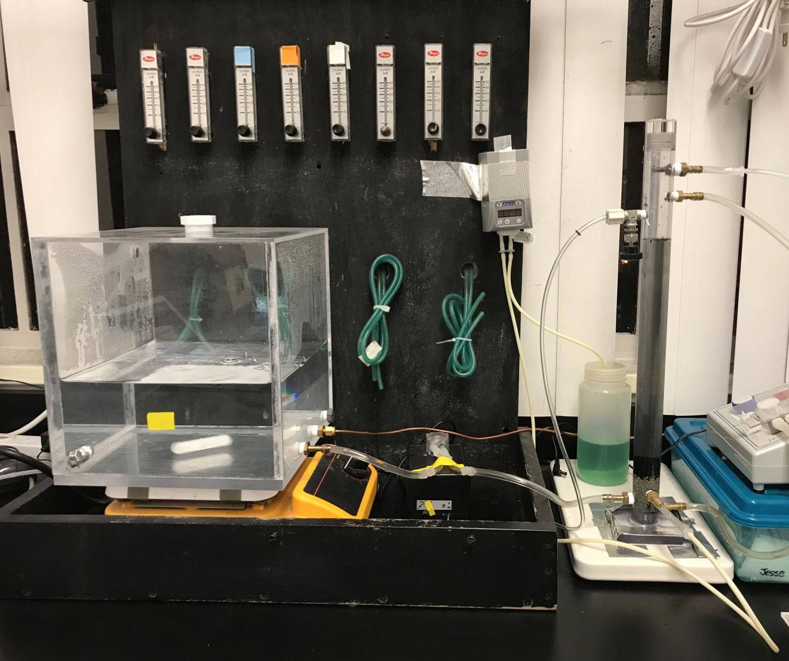
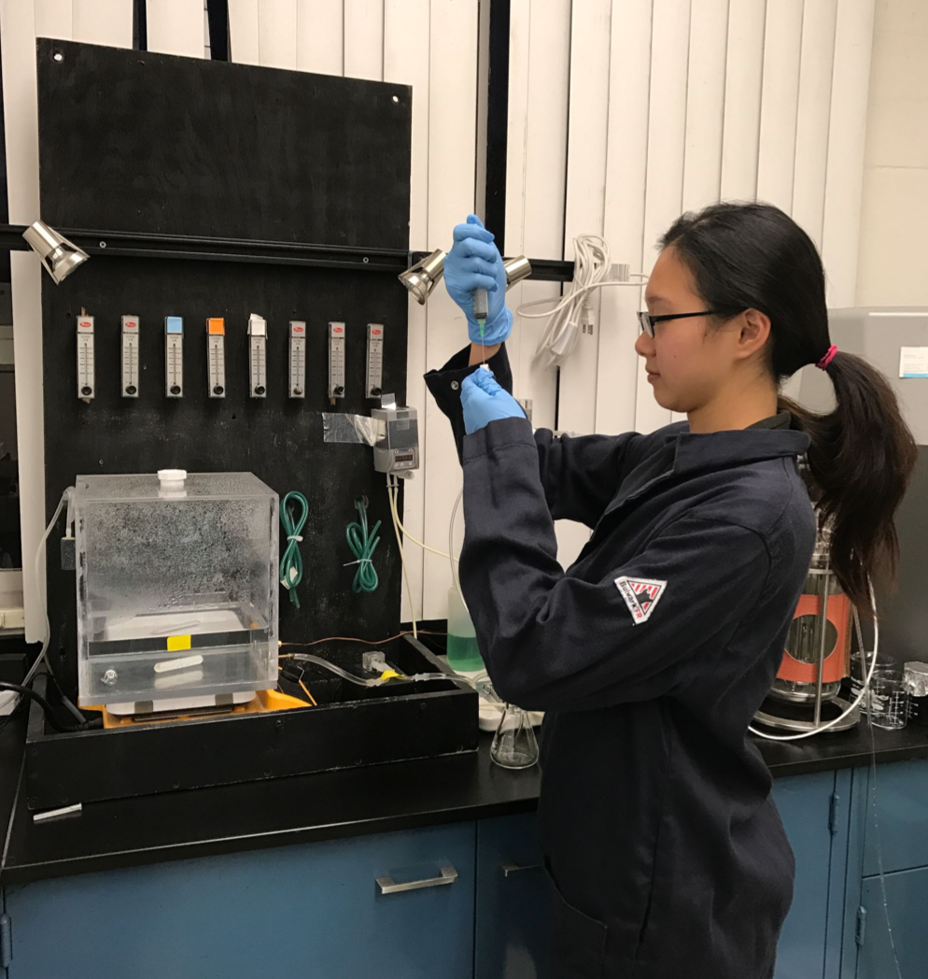
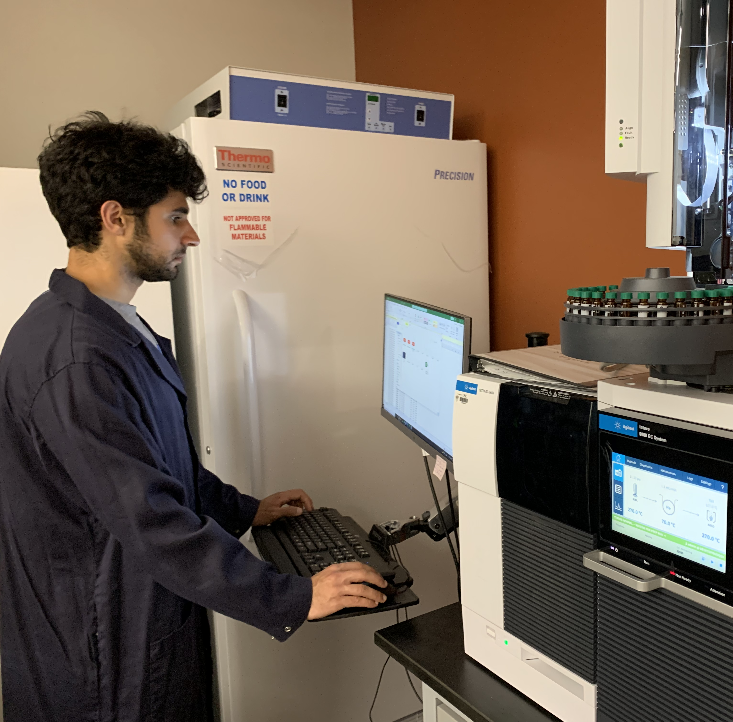
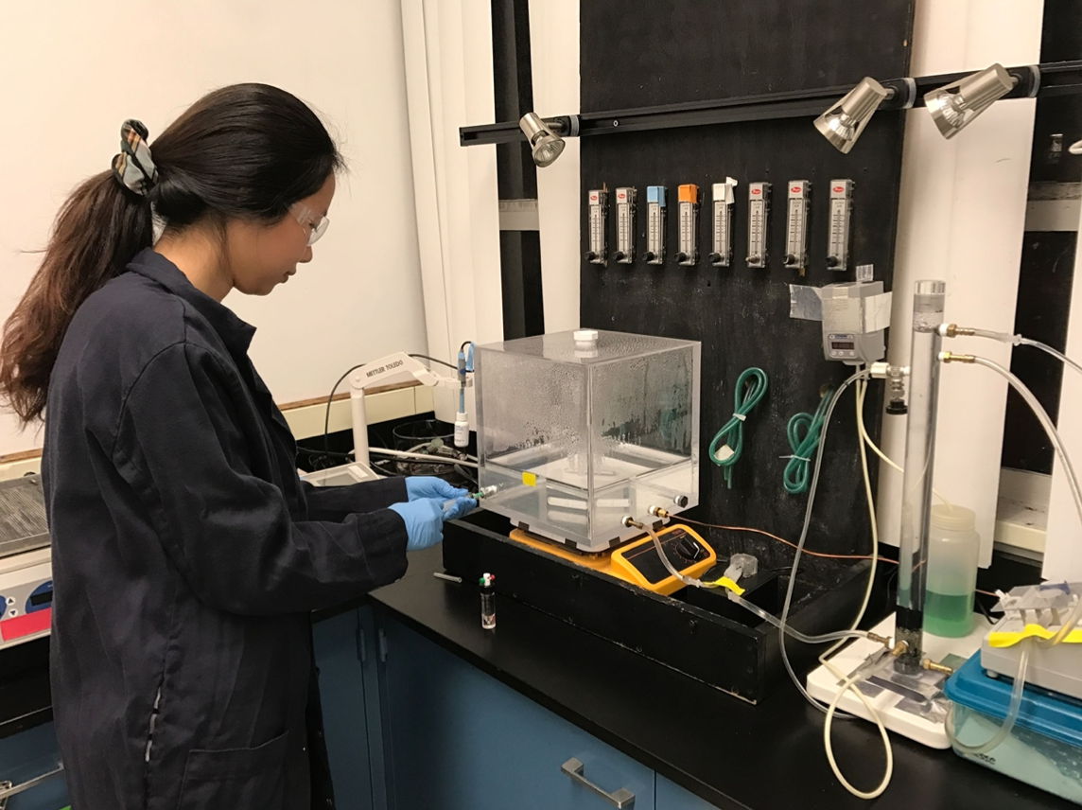
University of Southern California, Viterbi School of Engineering, Civil and Environmental Engineering
Microbial Conversion of Methane to Methanol Employing a Fluidized-bed Biofilm Reactor with Recycle (Part I)
Research Objectives
Undergraduate Research Students: Michael Nazari, Cindy Qi, and Justine Lee
Faculty Advisor: Professor Mike Pirbazari
Results and Discussion
Convert methane (CH₄), an abundant greenhouse gas (GHG), to methanol (CH₃OH), a valuable combustion fuel, using two different methanotrophs. The goal of these experiments is to:
Employ methanotrophic bacteria to produce methanol.
Determine the most generative bacteria species.
Prove viability of methane-to-methanol conversion for easy commercial use.
In this study, nearly 100% of methane was converted to methanol (Figures 3 & 4).
Methane oxidation depended on the oxygen saturation level of the aqueous solution.
Addition of optimum quantity of cyclopropanol to the bioreactor prevented formation of formaldehyde.
• Fluidized GAC bed with recycle provided ideal condition and
minimized the loss of enzymes produced by methanotrophs.
Experimental Methods
The bacteria was incubated by heating a solution of nutrients and buffer for several days. After bacterial growth, the solution was mixed with granular active carbon (GAC) to adsorb the bacteria and then transferred to the bioreactor. Methane was added to the dissolution tank and then the liquid is pumped from the tank into the bottom of the bioreactor. Nutrients were added periodically to ensure suitable conditions for bacteria. After flow through the fluidized bed reactor was complete, samples were withdrawn from the bioreactor and prepped for gas chromatography (GC) analysis.
At first, higher doses of nutrients were added to encourage bacteria to acclimate to the new environment. As the culture grew, less nutrients were added.
Before adding the methane, the reactor was oxygenated to provide ideal conditions for the aerobic methanotrophs.
The recirculation pump minimized the loss of essential enzymes produced by bacteria and thus increased the efficiency of methane production.
Schematic diagram and laboratory experimental setup are presented in Figures 1 & 2.
Rationale
Two of society’s greatest challenges today are finding sustainable way to produce fuels from non-petrochemical sources and at the same time reducing greenhouse gas (GHG) emissions.
Biological routes offer the most promising alternative, and the attention has been mostly on using lignocellulosic biomass as the feedstock, which avoids conflict with the food chain.
The conversion of methane to methanol is desirable because methane is liquid in room temperature allowing for safer storage, easier transport, and a greater energy density.
As well as being used as an alternative fuel source, methanol in the chemical industry is used as a building block for other chemicals, as antifreeze, and as a precursor to other compounds.
Conventional methods for synthesizing methanol from methane suffer from drawbacks such as inefficiencies, costs, and high energy consumption.
The method of utilizing methanotrophs to produce methanol from methane allow for a safer storage, easier transport, and greater energy density.
• The commercial success of biocatalytic methane to methanol
conversion may be the beginning for a shift from petroleum
to gas-based refineries.
Model Formulations
The following equations are used to model the performance of the Recycled Fluidized-bed Biofilm Reactor.
Liquid Phase Material Balance:
$$\frac{∂C\left(x,t\right)}{∂t}=D_{d}\frac{∂^{2}C\left(x,t\right)}{∂x^{2}}−υ_{x}\frac{∂C\left(x,t\right)}{∂x}−\frac{3k_{fc}\left(1−∈\right)}{∈}\frac{{\left(R+L_{f}\right)}^{2}}{R^{3}}\left[C\left(x,t\right)−C_{fc}\left(x,t\right)\right]$$
Solid Phase Material Balance in Adsorbent:
$$\frac{∂q\left(r,t\right)}{∂t}=\frac{D_{s}}{r^{2}}\frac{∂}{∂r}\left[r^{2}\frac{∂q\left(r,t\right)}{∂r}\right]$$
Diffusion and Reaction in Biofilm:
$$D_{f}\frac{∂^{2}C_{f}\left(x,z,t\right)}{∂z^{2}}=\frac{kX_{f}C_{f}\left(x,z,t\right)}{Y\left[K_{s}+C_{f}\left(x,z,t\right)\right]}$$
Growth of Biofilm:
$$\frac{∂L_{f}\left(x,t\right)}{∂t}=\frac{kC_{favg}\left(x,t\right)L_{f}\left(x,t\right)}{K_{s}+C_{favg}\left(x,t\right)}−K_{d}L_{f}(x,t)$$
Adsorption Equilibrium Relationship:
$$q\left(r=R,x,t\right)=K_{F}C_{s}{\left(x,t\right)}^{n}$$
Figure 3: Data showing percent of methanol production as a function of time.
Fundamentals
Figure 4: Data showing percent methane consumption as a function of time.
Methanotrophic bacteria are aerobic and use methane monooxygenase (MMO) enzymes to catalyze oxidation of methane to methanol in a single step at ambient temperature and pressure (Hanson & Hanson- 1996). Methanol is
subsequently metabolized to formaldehyde by methanol
dehydrogenase (MDH), which is converted in turn to formate
by formaldehyde dehydrogenase.
Ob3b bacteria were cultivated in a batch reactor for ten days on a mineral medium similar to that described by Markowska & Michalkiowicz (2009).
Methane oxidation by OB3b bacteria is most efficient when the mineral medium contains appropriate quantities of copper.
The consumption of methanol by the MDH enzyme must be inhibited in order to accumulate methanol product.
It is important to select an appropriate support medium for immobilization of methanotrophic bacteria cells.
Future Work
Numerical Method
Optimize reaction conditions to enhance process yield.
Conduct simulation modeling to identify the key parameters influencing process dynamics.
Optimize the copper concentration to achieve ideal bacterial growth.
Continue working with a promising Type (II) methanotrophic bacteria., the results of which will be presented in Part (II).
A hybrid computational technique that involves the orthogonal collocation
method and the Crank-Nicholson finite difference scheme will be employed
to obtain long-term prediction of bio-adsorber effluent profiles.
Researchers in the Lab
References
Acknowledgements
A. Markowska, & B. Michalkiowicz , Chemical Paper 63(2) 105-110 (20090)
R. Hanson & T. Hanson, Methanotrophic Bacteria, Microbiology Review, 60 (439-471 (1996)
OB3b bacteria was graciously provided by Professor Marina Kalyuzhnaya from San Diego State University.
We would like to thank Mile Castleman and Tengge Zhang for their assistance in this project.
Figure 1: Schematic Diagram of the Setup
Figure 2: Laboratory Experimental Setup

