Slide 1
A Review of Current Desalination Technologies In Developing and Developed countries
By: Peter Grasso, Howard Gil, and Aja Canyon (Undergraduate Students)
Faculty Supervisor: Professor Massoud Pirbazari
Sonny Astani Department of Civil and Environmental Engineering
Viterbi School of Engineering
University of Southern California
**This Presentation is a Work in Progress**

Slide 2

SWAN is an initiative started by Professor Massoud Pirbazari of the University of Southern California focusing on the improvement of drinking water quality for citizens of developing countries. SWAN's goal is to provide comprehensive and visually based information so that people, at the household level, can treat their water, and in turn, improve their health and well-being.

Slide 3
Note to the Reader
THIS SITE IS UNDER CONSTRUCTION AND WILL BE FINALIZED IN THE NEAR FUTURE
All material included in this presentation have been adapted from sources* listed on the final slide.
* We would like to thank those whose work has been pivotal in the creation of this site. (See Reference Page for Sources)

Slide 4
Table of contents
General Information
Purpose
Water Crisis
Finding a solution
Small Scale Desalination efforts
Solar Stills
Large Scale Desalination Efforts
Reverse Osmosis
Forward Osmosis
Electro-Diaylsis (ED)
Multiple Effect Distillation (MED)
Multi Stage Flash (MSF)
Vapor Compression

Slide 5
Table of contents (continued)
Renewable Energy Sources for Desalination
  Solar thermal
  Solar Photovoltaics (PV)
  Concentrating Solar Power (CSP)
  Wind Power
  Geothermal
  Wave Power

Slide 6
Purpose
The purpose of this presentation is to outline current, effective desalination technologies used worldwide. This presentation will offer different desalination technologies ranging from implementation in single family households in developing nations to entire cities in developed nations. We hope to inspire future projects, building upon the ones shown in this presentation.

Slide 7
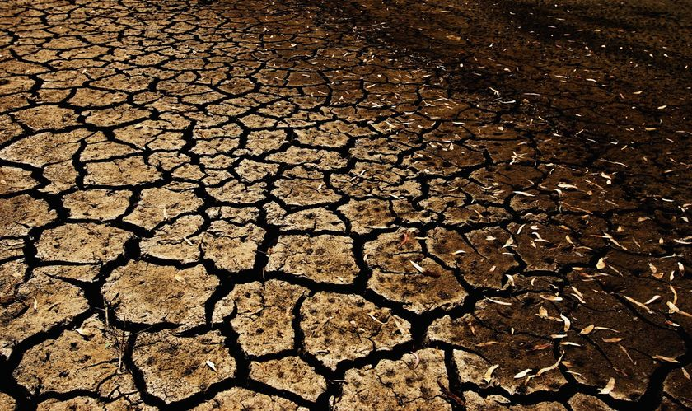
Worldwide Water Crisis
1 out of 11 people lack access to clean water
This is a problem for both developing nations and developed nations
By 2025 it is forecasted that 2/3 of the worlds population will live under water stressed conditions with 1.8 billion people living in areas of absolute water scarcity
In many arid regions surface water sources and shallow wells being depleted at an unsustainable rate
Drilling to access the water table is costly and requires specialized drilling and pumping equipment
Additionally shallow wells and surface water sources often contain poor quality water that can be brackish and salty
Consumption of poor quality water can lead to adverse health impacts
  3.4 million people die every year form water related diseases.
The water scarcity trend is projected to increase as global population increases
Global warming also plays a major role in an increase of water scarcity as localized climates change

Slide 8
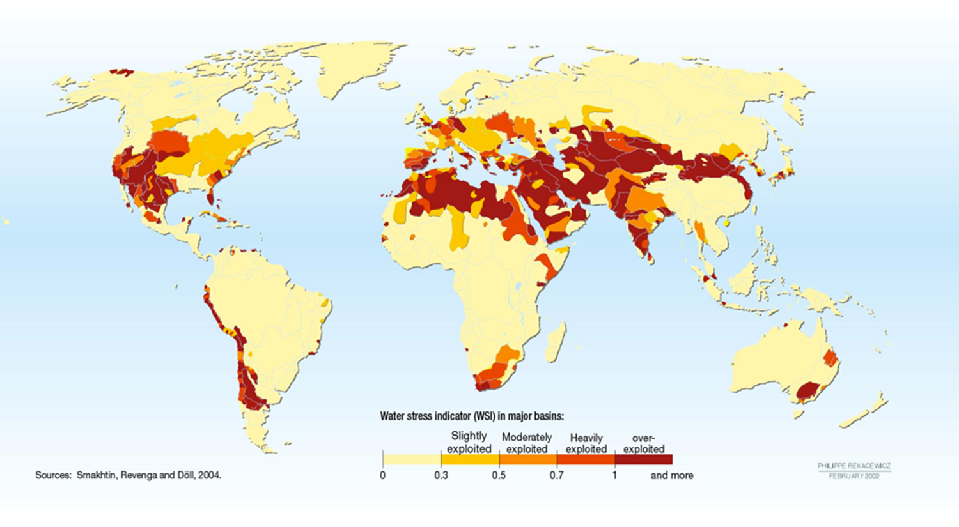
the wORLD Regions Deeply Affected

Slide 9
Addressing the problem and finding a solution: desalination
Desalination can play a large role in increasing the supply of fresh water in both developing and developed nations
Desalination is the process of removing salt and other dissolved solids from water in order to produce water suitable either for human consumption or agricultural purposes and industrial processes
Desalination not only pertains to sea and ocean water but also to brackish water such as agricultural and industrial waters.

Slide 10
“Practical” WORLDWIDE LOCATIONS for Desalination TECHNOLOGY
Desalination of seawater accounts for a worldwide water production of 65.2 million m³/year (0.6% of global water supply).
The Middle East and North Africa (MENA) account for 38% of global desalination efforts, but other regional centers of activity are becoming more prominent, such as the Mediterranean Sea and the Red Sea, or the coastal waters of California, China and Australia.^{[1]}
Countries in the Gulf region face the largest per capita water scarcity in MENA, with an average water availability of less than 300m³ per capita per year. ^{[2]}
Desalination is a lot more practical in these seas because they have a lower salinity than the ocean which significantly lowers energy consumption requirement.

Slide 11
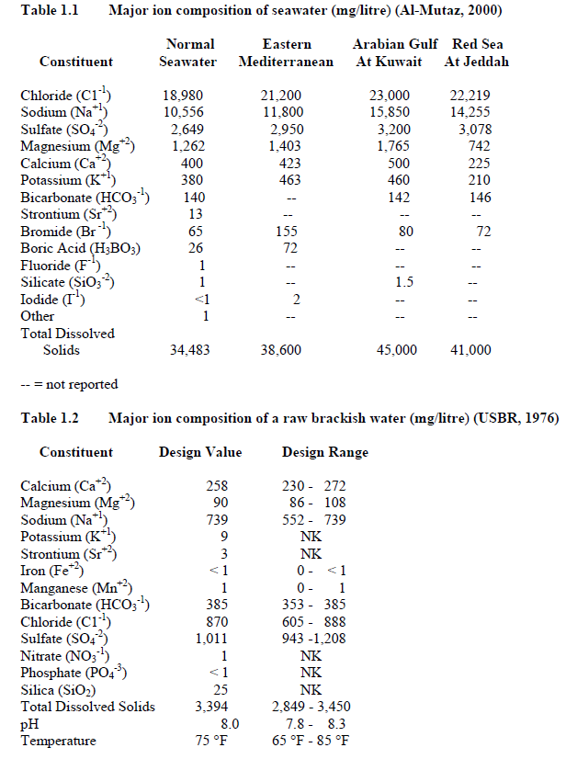
A Comparison of Seawater and Brackish Water
Major Ion Component of Seawater
The concentration of total dissolved solids (TDS) in Seawater is 3.5 to 35 times greater than concentration in brackish water
  Brackish water: 1,000 -10,000 mg/L TDS
  Salt water from the ocean: ~35,000 mg/L TDS
Brackish water is significantly cheaper and easier to desalinate due to its smaller concentrations of TDS
Brackish water is readily available in many nations
Major Ion Component of Brackish Water
Notes:
Too wordy, condense

Slide 12
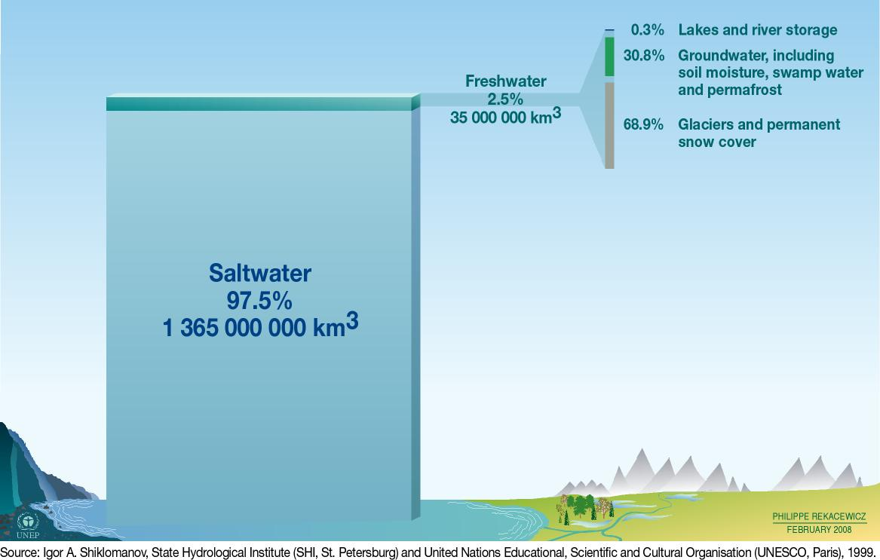
Distribution of Water Supplies

Slide 13
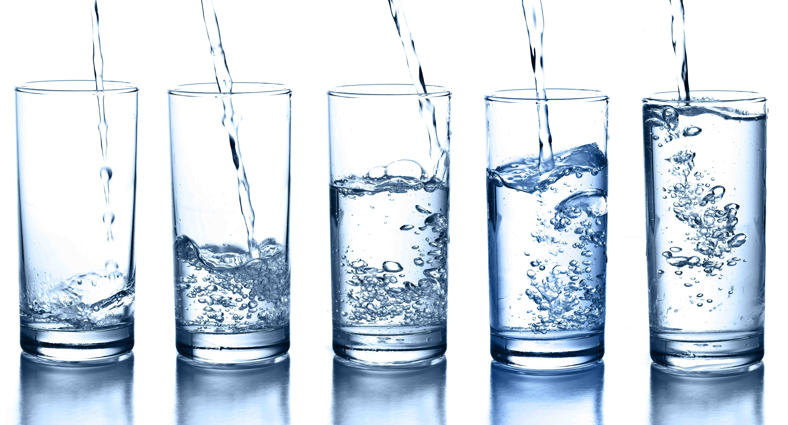
Water Requirements in Developed and Developing Nations
A human needs roughly 4 liters (~1 Gallon) of water a day to stay hydrated and survive
An average person in the United States uses 380 liters/day (~100 gallons)
Notes:
Ayoub, J., and R. Alward. "Water Requirements and Remote Arid Areas: The Need for Small-scale Desalination." Desalination 107.2 (1996): 131-47. Print.

Slide 14
Desalination Solutions for Single Family and
MultI-family Households in Developing Nations
Major methods of providing fresh water for inhabitants of rural areas include drilling, piping, trucking, resettlement, and desalination
While in the long term drilling for freshwater is generally preferred drilling activity requires highly technical and expensive drilling equipment
Additionally the water found in the drilling process is often brackish and therefore unsuitable for human consumption
Due to the high cost of most desalination technologies and other water production techniques, use of solar still technologies are recommended the method of desalination for both single and multifamily households
Solar Stills are best utilized in situations where the demand for fresh water is small and land is inexpensive
Solar Stills are inexpensive and require less technical knowledge to design and construct
Solar Stills can help promote self reliance and enable communities to develop further

Slide 15
Desalination Technologies in Developing Nations
Towns And CITIES
Desalination Technologies for larger operations have significant a capital cost and energy requirement
The European Union funded a report assessing the best available technologies for desalination in rural/local areas
  This report assessed the current state of 11 different desalination technologies
The best low cost and effective desalination method for local areas seems to be Electro-diyalsis (ED)

Slide 16
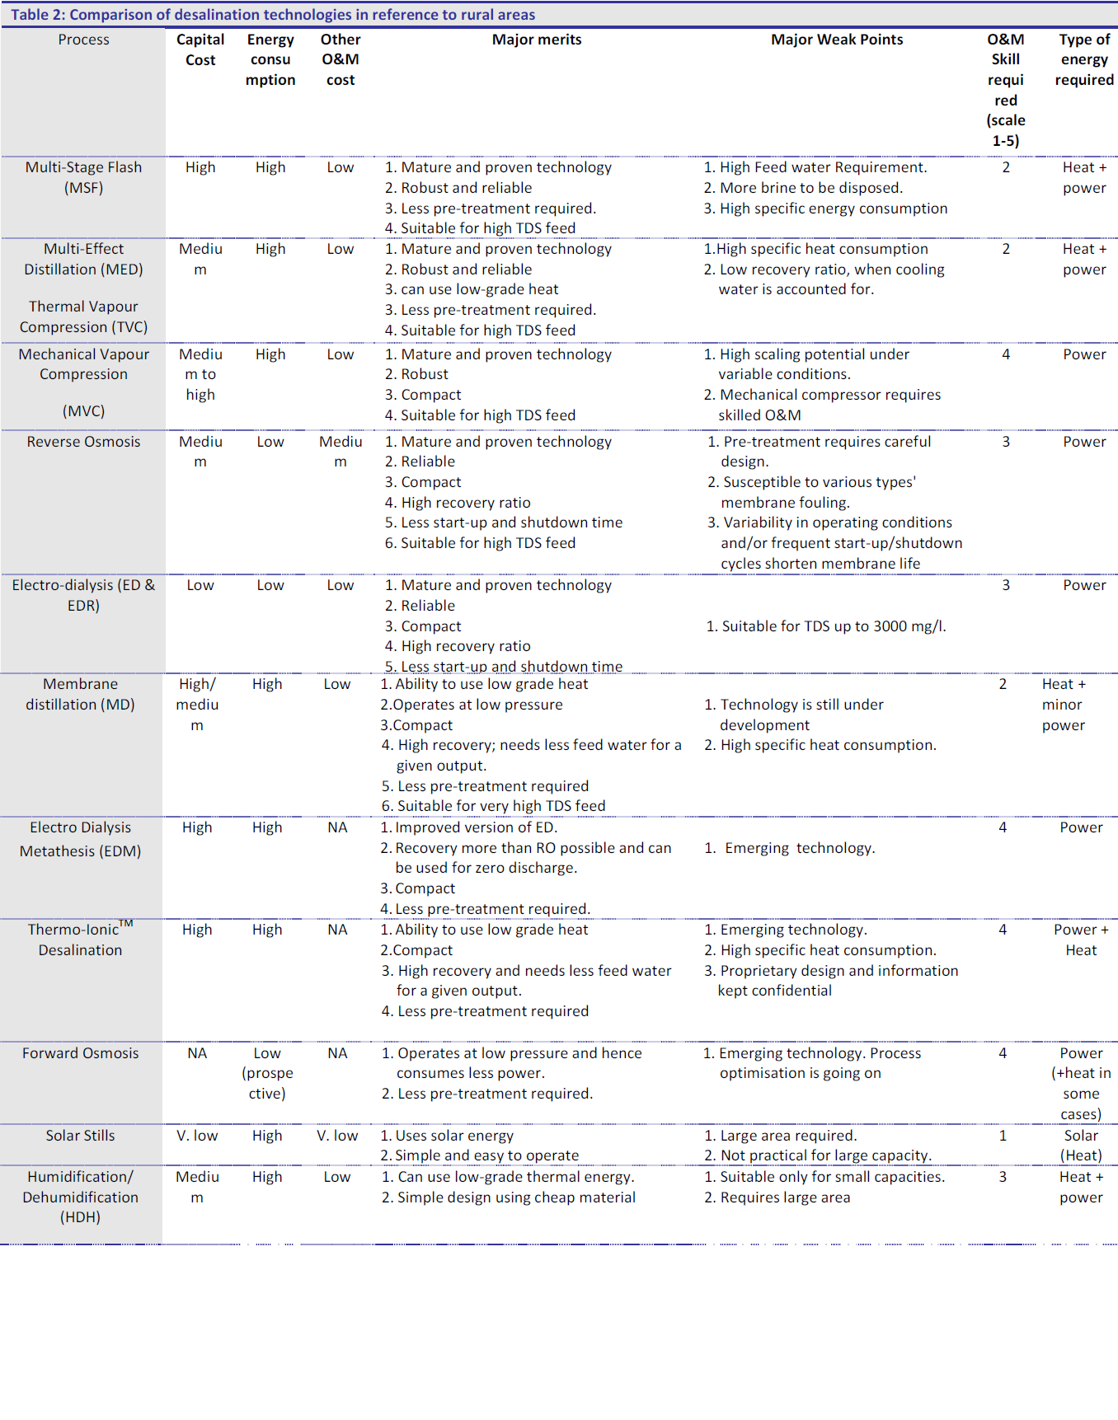

Slide 17
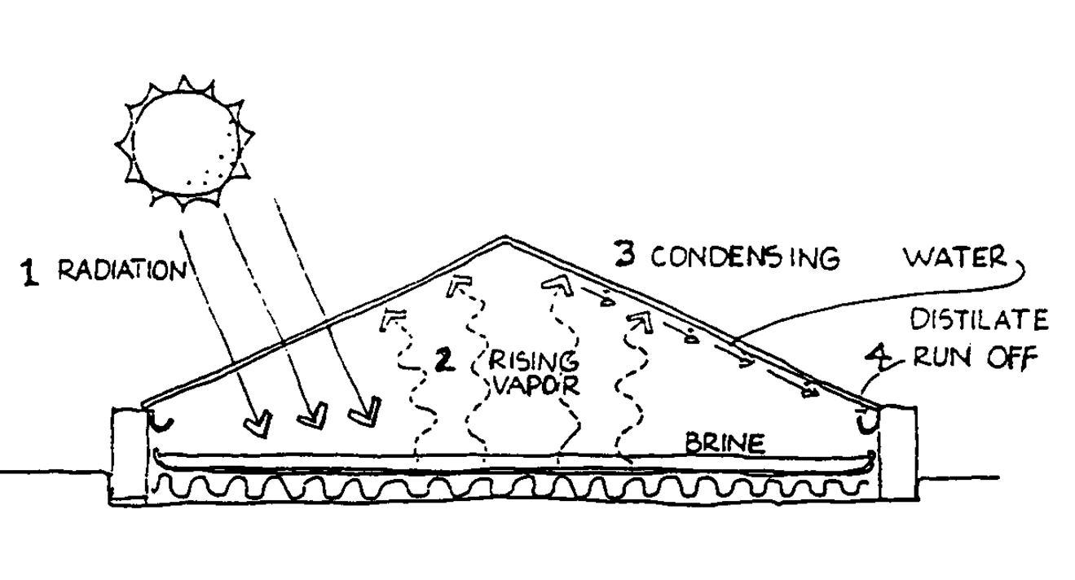
Solar Stills
Solar stills are a simple solution to water quality problems in rural parts of developing nations
Solar stills are a low-cost treatment option
A solar still absorbs solar radiation in order to evaporate brine water
The evaporated water condenses on the inside of the solar still cover
This distilled water then drops into a collector where it is stored and is readily available for consumption
The basic design for a solar still is a wooden frame with a glass or plastic cover for insulation and a darkly colored absorber bed
A solar still’s fresh water production varies anywhere from 2-7L/m^2/day. These water production variations are due to design geometry differences

Slide 18
Solar Stills
Advantages:
Low Cost
Easy to build
No additional chemicals needed to treat water
Disadvantages
Low production yield 2 – 7 L/M²/day
Not economically viable for large-scale applications
Large land requirements to scale up size of operation
Notes:
Historical perspective developing vs developed PURPOSE. Give a review of

Slide 19
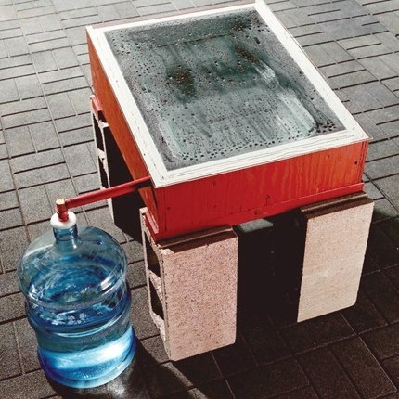
Solar Still Variations
Cover: can be made of glass or other transparent materials, and can be given a number of different glosses that vary in efficiency (amount of water condensed), cost, and availability
Additives: several solar stills use brine or another substance to aid in water absorption
Spout run-off: after the clean water falls out of the still, it can be put through a variety of run-off for further cleaning. Example: slow sand filter
Design: multiple slopes, addition of trays, tilt, etc.
Notes:
Picture and change where it is

Slide 20
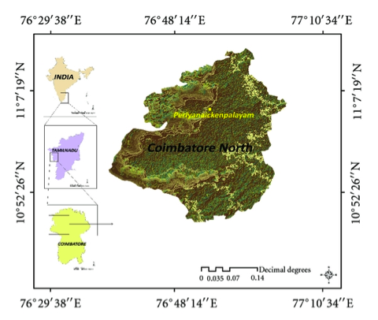
Solar Still Designs in INdia
Location: Coimbatore, Tamil Nadu, India
Dates of testing: January – May 2011
Study compared output from 6 different solar still designs to determine which had the greatest yield (Spherical, Double-Basin, Pyramid, Hemispherical, Tubular, Tubular w/ Pyramid)
Notes:
Arunkumar, T., K. Vinothkumar, Amimul Ahsan, R. Jayaprakash, and Sanjay Kumar. "Experimental Study on Various Solar Still Designs." ISRN Renewable Energy 2012 (2012): 1-10. Print.

Slide 21
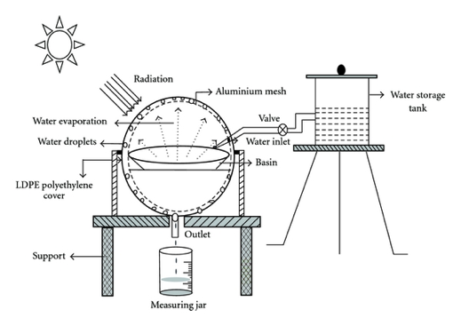
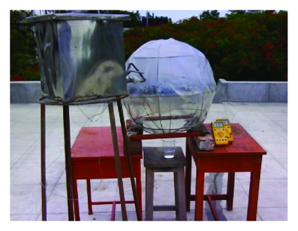
Spherical Circular Still
Collector Plate area: 0.28 m²Brackish Water Storage Capacity: 16 Liters
Production: 2.3L/m²/day
Notes:
Arunkumar, T., K. Vinothkumar, Amimul Ahsan, R. Jayaprakash, and Sanjay Kumar. "Experimental Study on Various Solar Still Designs." ISRN Renewable Energy 2012 (2012): 1-10. Print.

Slide 22
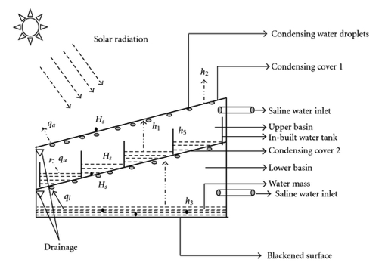
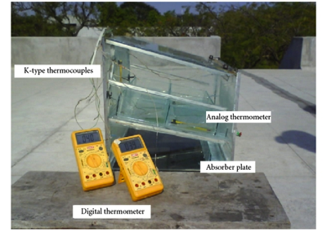
Double-Basin Glass Solar Still
Two stacked basins with dimensions:
  .590m x .440m x .440m
  .600m x .460m x .460m
Brackish Water Storage Capacity: 30L
Fresh Water Production: 3L/m²/day
Notes:
Arunkumar, T., K. Vinothkumar, Amimul Ahsan, R. Jayaprakash, and Sanjay Kumar. "Experimental Study on Various Solar Still Designs." ISRN Renewable Energy 2012 (2012): 1-10. Print.

Slide 23
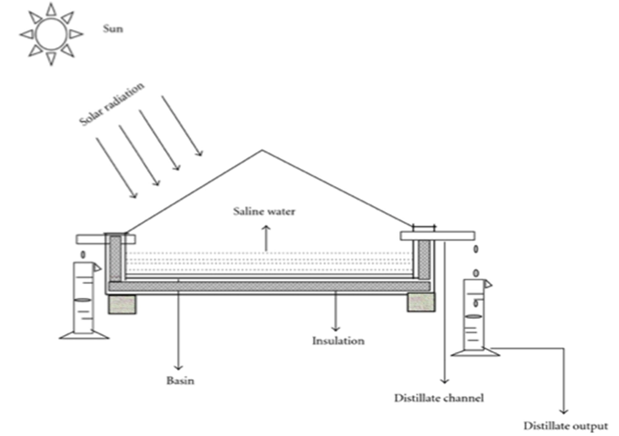
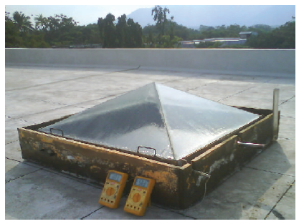
Pyramid Solar Still
Collector Plate area: 1.21m²
Brackish Water Storage Capacity: 60.5 L
Fresh Water Production: 3.4L/m²/day
Notes:
Arunkumar, T., K. Vinothkumar, Amimul Ahsan, R. Jayaprakash, and Sanjay Kumar. "Experimental Study on Various Solar Still Designs." ISRN Renewable Energy 2012 (2012): 1-10. Print.

Slide 24
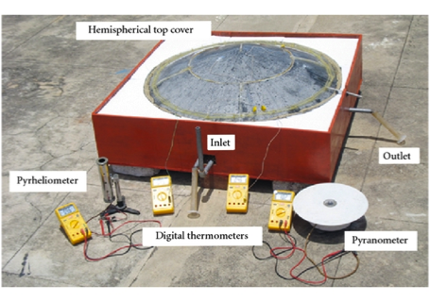
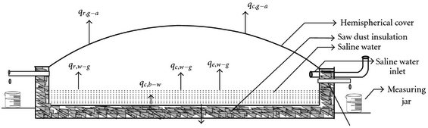
Hemispherical Solar Still
Collector Plate area: 1.21m²
Brackish Water Storage Capacity: 60.5 L
Fresh Water Production: 3.5L/m²/day
Notes:
Arunkumar, T., K. Vinothkumar, Amimul Ahsan, R. Jayaprakash, and Sanjay Kumar. "Experimental Study on Various Solar Still Designs." ISRN Renewable Energy 2012 (2012): 1-10. Print.

Slide 25
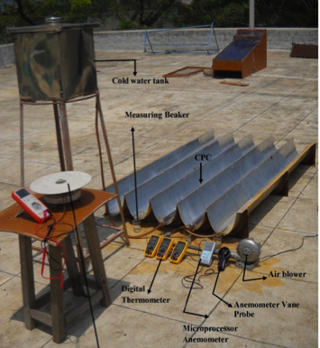
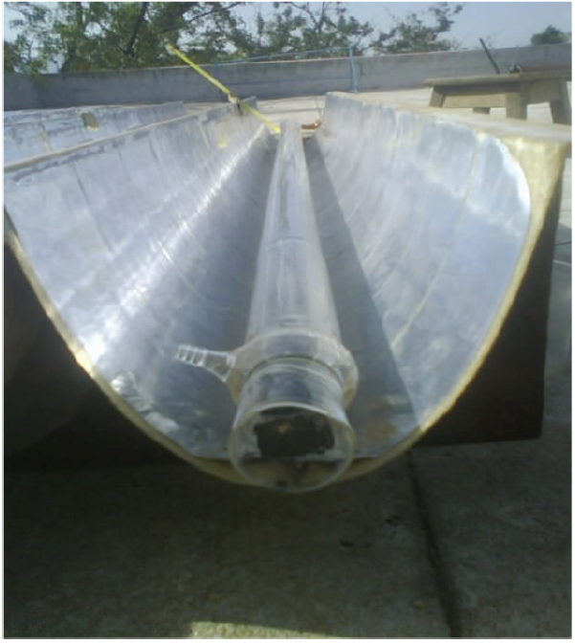
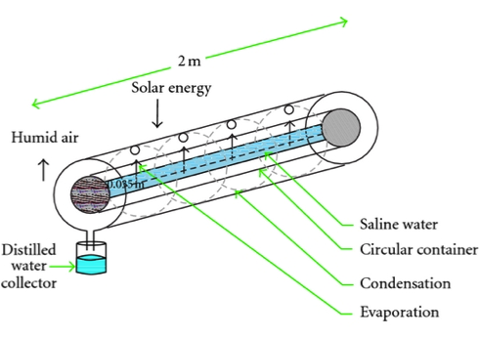
Tubular Solar Still
Brackish water is put into a tube and surrounded by a parabolic trough that absorbs solar radiation and causes condensation and evaporation cycle to occur
Glass tubes are 2 m long
Production: 4.5L/m²/day
Notes:
Arunkumar, T., K. Vinothkumar, Amimul Ahsan, R. Jayaprakash, and Sanjay Kumar. "Experimental Study on Various Solar Still Designs." ISRN Renewable Energy 2012 (2012): 1-10. Print.

Slide 26
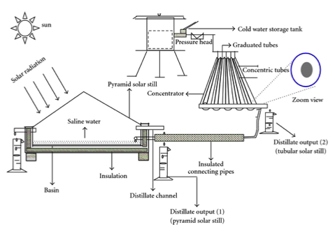
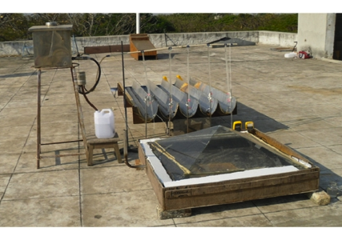
Tubular Solar Still coupled with Pyramid Solar Still
Brackish water flows from a tubular solar still into a pyramid solar still
Production: 6.8L/m²/day
Notes:
Arunkumar, T., K. Vinothkumar, Amimul Ahsan, R. Jayaprakash, and Sanjay Kumar. "Experimental Study on Various Solar Still Designs." ISRN Renewable Energy 2012 (2012): 1-10. Print.

Slide 27
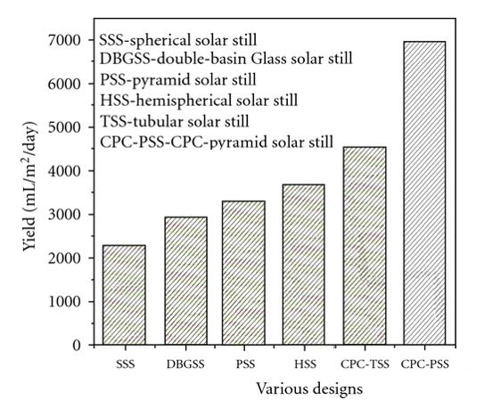
Water Production VARATIONS FROM Indian Solar Stills
The CPC Pyramidal Solar still produced the greatest quantity of water per day per square meter (~7L/m²/day)
Water production yield versus design of solar still
Notes:
Explain results of what: comparison of solar still technologies
Arunkumar, T., K. Vinothkumar, Amimul Ahsan, R. Jayaprakash, and Sanjay Kumar. "Experimental Study on Various Solar Still Designs." ISRN Renewable Energy 2012 (2012): 1-10. Print.

Slide 28
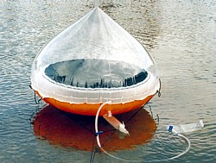
Aquamate Solar Still
Portable variation used for seawater
Clean water falls into the donut of the buoy and can be sucked through drinking tube
Used by U.S. military and life-raft survival kits

Slide 29
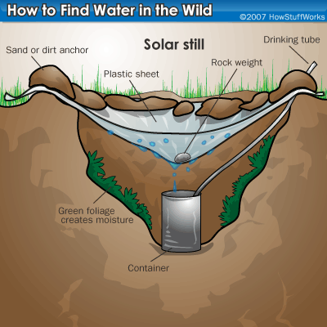
Primitive Solar Still
Traditional concept, uses very attainable resources and takes less than an hour to construct
Used mainly in survival scenarios but can be applied to village settings

Slide 30
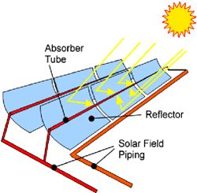
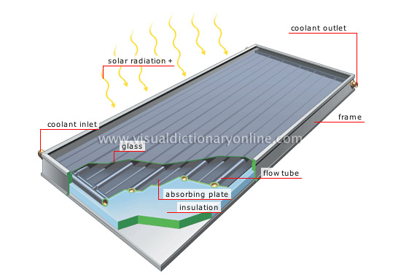
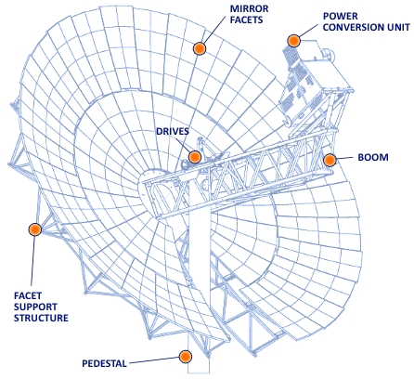
Solar Concentrator
Depending on the need, 3 types of concentrators exist (least efficient to most efficient): flat (stationary), parabolic (tracking), and dish (tracking)
Desalination application: (1) the concentrated solar energy can either directly heat the water to temperatures adequate enough to remove impurities, or (2) can focus the energy onto a plane of solar thermal collectors or photovoltaic panels that then power desalination plants
Flat
Parabolic
Dish
Flat solar collector merely absorbs and does not reflect rays, so it can be stationary, whereas the other two collectors must move in order to concentrate rays to a plane or point.

Slide 31
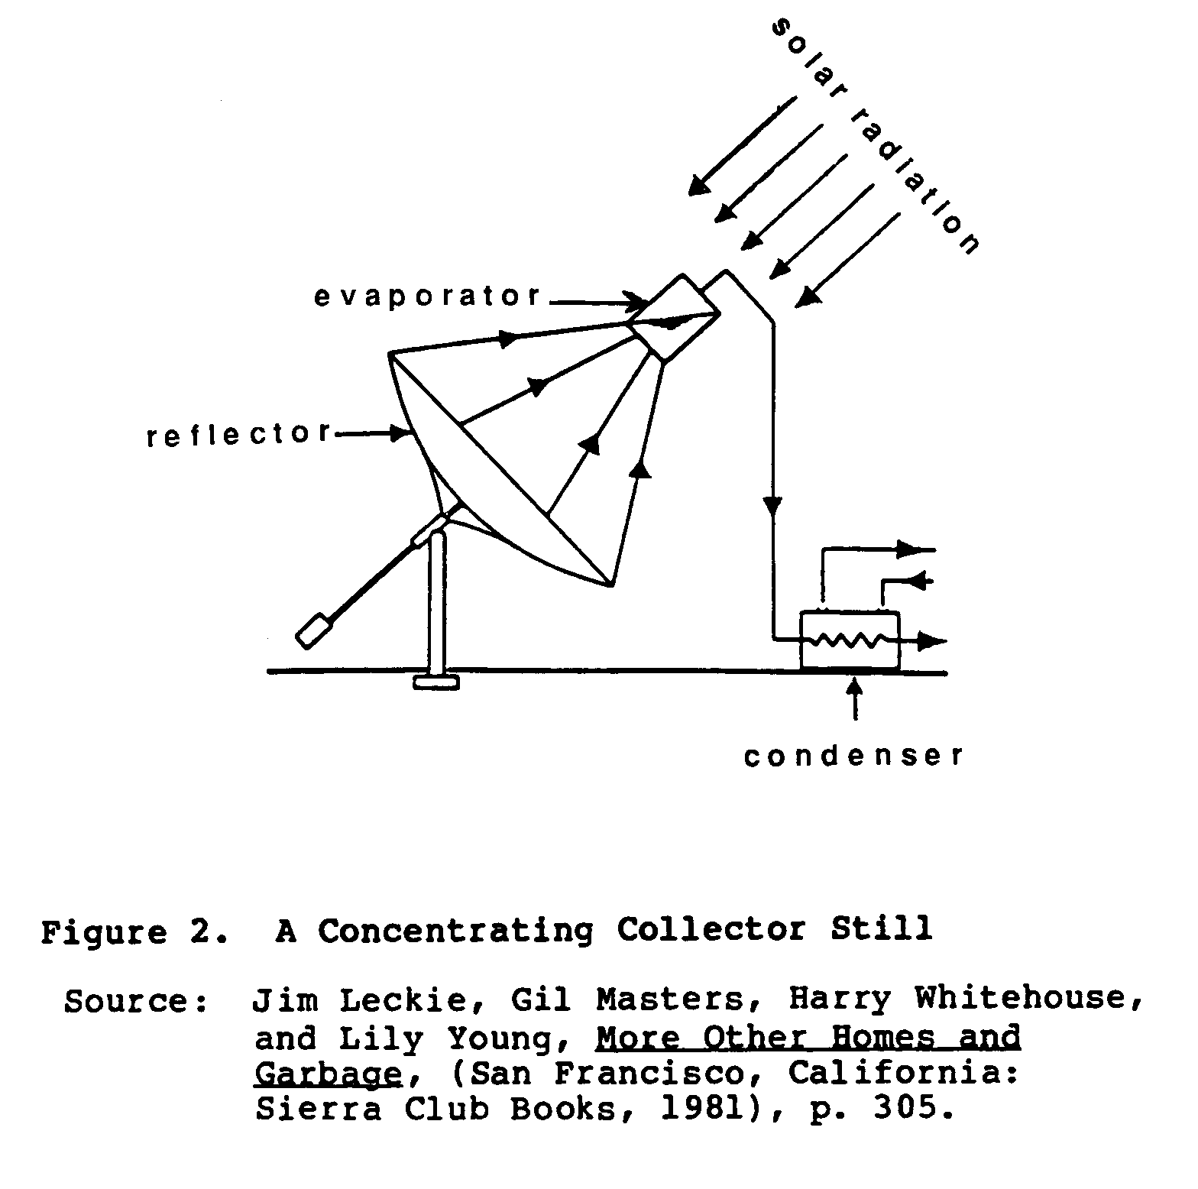
Concentrating Collector Still
Combines the concept of solar collectors and solar stills.
Solar heat is concentrated into a container of impure water, creating vapor that then runs through a tube where it is condensed. Example of heating water source directly.
Concentrating Solar Still Diagram

Slide 32
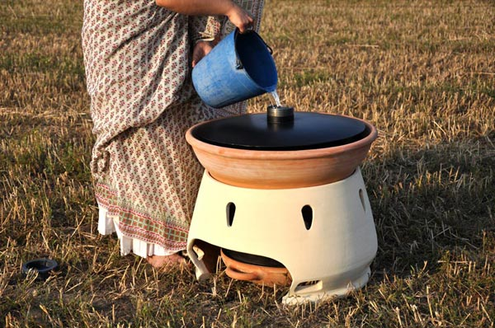
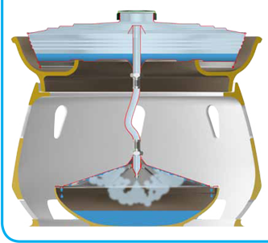
Eliodomestico
Ceramic pot that utilizes basic concept of boiling
Sun heats black boiler on top, turning it into steam which is forced down an expansion nozzle where it condenses against the lid
Yields 5 L/day
Estimated cost $50

Slide 33
Large Scale Desalination Efforts
Found areas of developed nations and countries which lack access to fresh water sources
Cheap and readily available energy sources, \but…more sustainable, opportunity for future growth
Even though MENA is not fully developed, their abundant access to oil and natural gas, as well their coastal location prompts large efforts in desalination as a means of freshwater production.
With greater access to capital and resources, and a greater population to service, these countries are on the forefront of advancing and expanding desalination technologies.
Notes:
#Lack of freshwater reserves

Slide 34
State-of-the-Art Desalination Methods
Two Major types of processes:
  Membrane:
    Reverse Osmosis (RO) (~ 60% of global desalination capacity)
    Forward Osmosis (FO)
    Electrodialysis (EDR)
  Thermal:
    Multi-Effect Distillation (MED)
    Multi-Stage Flash (MSF) (~26.8% of global capacity)
    Membrane Distillation
    Vapor Compression
Notes:
Explain Desalination vs. Basic Filtration

Slide 35
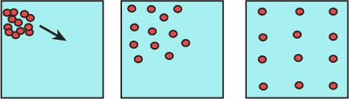
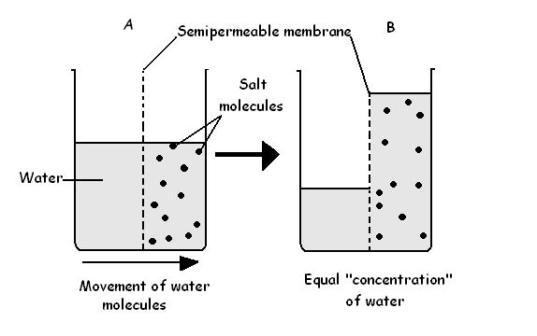
Review of Membrane Methods:
Reverse Osmosis
Diffusion
In order to understand reverse osmosis, it is best to first understand Osmosis
Osmosis is a specialized type of diffusion
Diffusion is the movement of a substance or particles from a region of high concentration to a region of low concentration
In Osmosis two solutions with different concentrations of dissolved constituents are separated by a semi-permeable membrane
Osmosis is the natural movement of a solvent(in this case water) through the semipermeable membrane from a low concentration of solvent (in this case salt) to the side with a high concentration of solvent in order to establish an equilibrium. When equilibrium is established there will be an osmotic pressure acting which can be seen by the difference in height of the two columns of water.
Process of diffusion over time
Osmosis

Slide 36
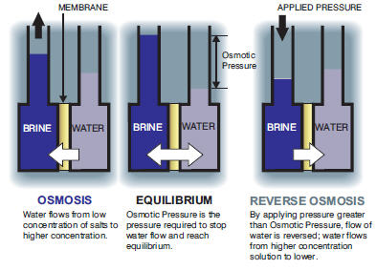
Reverse Osmosis Process Explained
Reverse osmosis occurs when a force is applied to the side concentrated with the solute (in this case salt) causing solvent (water) to less concentrated side of the permeable membrane thus producing fresh water.

Slide 37
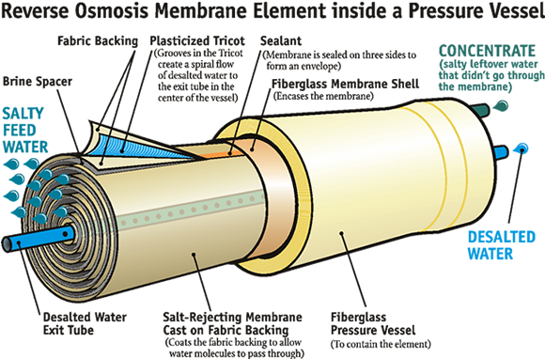
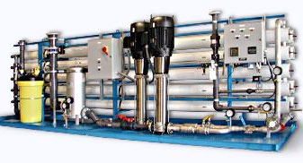
Reverse Osmosis
Most common method (~60% of desalination efforts)
Seawater pressure is increased above osmotic pressure allowing for desalinated water to pass through the semi-permeable membrane
The Semi-permeable membrane only allows water to flow through, leaving the salts behind
Typically a seawater RO plant produces 55-65 liters of fresh water for 100 liters of seawater
Where the energy is used: pumping the water through the pre-filtering, the semi-permeable membrane, and desalted/brine outputs
Energy Consumption 3.5-5.0 kWH of electricity / m³
Use of ultrafiltration membranes and renewable energy is making this technology more suitable
Consistant water quality is required to increase the lifespan of the membranes therefore pretreatment of the salt water is required

Slide 38
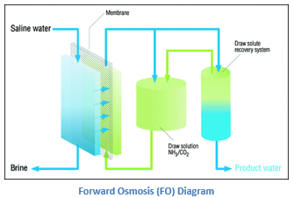
Review Of Membrane Methods:
Forward Osmosis
In forward osmosis the seawater or brackish water flows on one side of a membrane and the water on other side contains ammonium (NH₄⁺). The ammonium creates an environment with a high osmotic pressure which helps pure H₂O in the seawater or brackish water quickly diffuse to the other side.
The new solution can then either be subject to heat treatment or a secondary membrane to separate the ammonium and produce clean drinking water.
Energy consumption ~30% less than RO

Slide 39
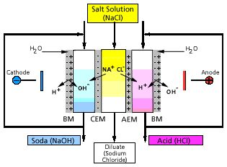
Review of Membrane Methods:
Electro-dialysis (ED)
ED accounts for 3.6% of the global desalination capacity
A series of ionic and anionic membranes are lined up between two electrodes and a low DC voltage is applied causing the ions in the brackish water to migrate to the electrodes.
Suitable for TDS of up to 12,000 mg/L
Energy Consumption: 1.5-4.0 kWh/m³ for feed water with 1500-3500 ppm solids
Typical Plant Max Capacity: 45,000 m³/day

Slide 40
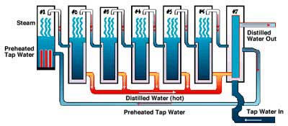
Review of Thermal Methods:
Multiple Effect Distillation (MED)
MED accounts for 8.0% of global desalination capacity
Consists of multiple stages ("effects”) where the feed water is heated by steam in tubes. Some of the water evaporates, and the remaining steam flows into the tubes of the next stage, heating and evaporating more water. Each stage reuses the energy from the previous stage.
Where the energy is used: heating/pressurizing the water into steam

Slide 41
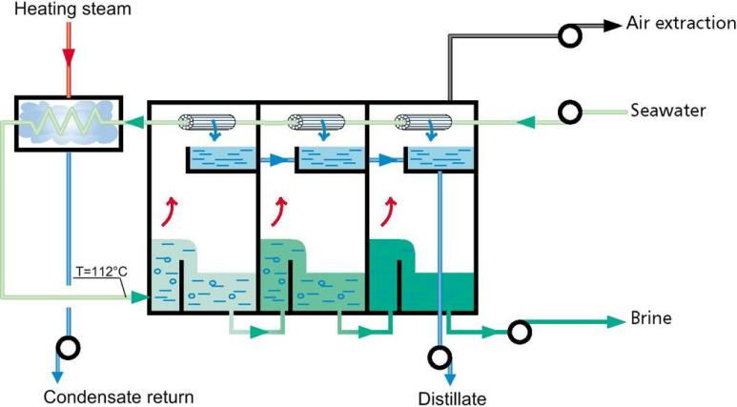
Review of Thermal Methods:
Multi Stage Flash (MSF)
MSF process accounts for 26.8% of global desalination capacity
Seawater or brackish water is heated between 90-110 degrees Celsius and the tanks decrease in pressure at each stage
The decreases in pressure allow water to flash (quickly vaporize)
The MSF process can be powered by waste heat making it commonly used in the MENA area due to the large resources of readily available, cheap fossil fuels
Where the energy is used: water must be pumped through each stage, as well as vaporized into steam and later condensed. Separate needs include air extraction and pumping of the condensate, distillate and brine outputs.
Energy Consumption: ~80.6kWH of heat plus 2.5-3.5 kWH of electricity per m³ of water

Slide 42
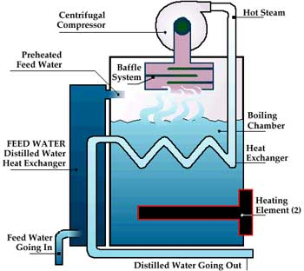
Review of Thermal Methods: Vapor Compression
Evaporation of feed water is achieved by the application of heat from compressed vapor.
The vapor is compressed either by steam or mechanically.
Where the energy is used: compressing the vapor - either heating the steam or moving the mechanical device (e.g. compression turbine).

Slide 43
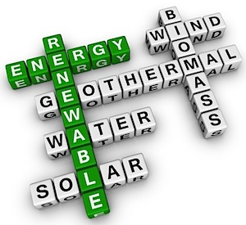
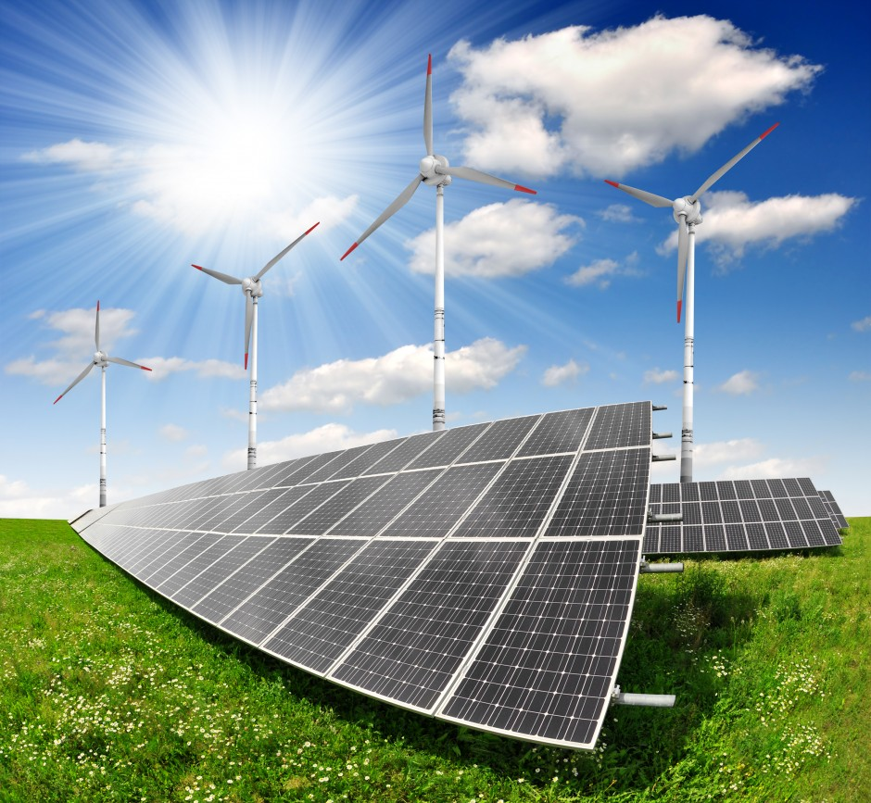
Renewable Energy Potential In Desalination Efforts

Slide 44
Implementation of Renewable Energy Usage in Desalination efforts
The addition of renewable energy sources to desalination efforts can make the process more sustainable
Fossil fuel prices are predicted to continue to increase in price while renewable energy technologies are expected to decline in cost
There are two major ways renewable energies can be utilized in desalination efforts
  Distillation processes driven by heat produced directly from the renewable energy system
  Membrane and distillation processes driven by electricity or mechanical energy produced by the renewable energy system
Renewable energy sources that could be utilized in desalination efforts include:
  Solar thermal
  Solar Photovoltaics (PV)
  Concentrating Solar Power (CSP)
  Wind Power
  Geothermal
  Wave Power
Renewable energy can be used on a case to case basis depending on the sources of energy available in a given area

Slide 45
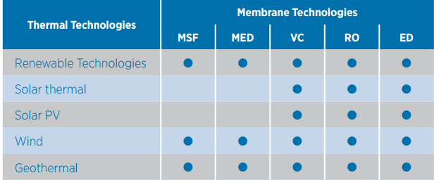
Applicability of various Renewable energy sources to Various desalination technologies

Slide 46
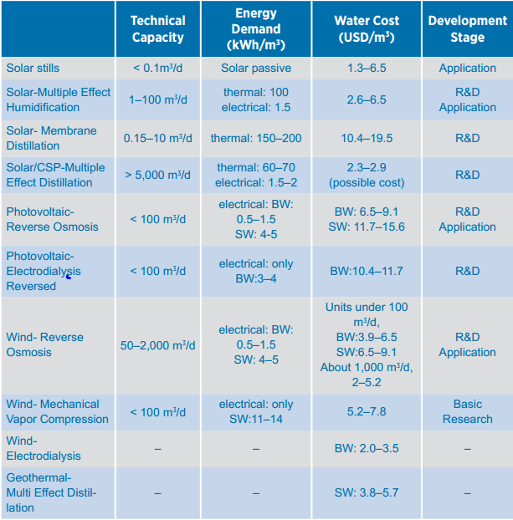
Comparative Cost Analysis of common methods of Desalination using Renewable energy Sources

Slide 47
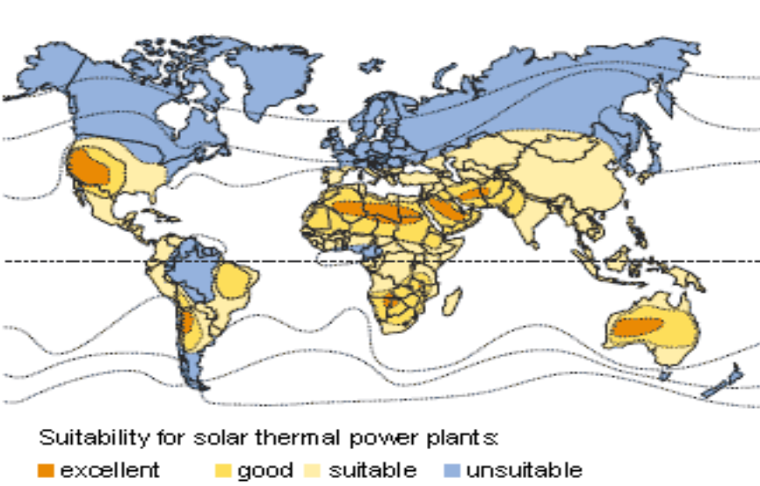
Solar Thermal Desalination
Solar Thermal can either be direct or indirect
  Direct with solar condensers and collectors integrated into one unit
  Indirect with condensers connected externally to collectors
Direct systems are relatively low cost and simply to construct (i.e. solar stills) but require large areas of land and have low fresh water production
Indirect Systems (MED, MSF) are able to produce greater quantities of fresh water but have a higher capital cost

Slide 48
Photovoltaic Desalination
Solar panels can be used to generate electrical energy which can then be used in the RO process
Fluctuations in power generation is to be expected as the input of solar energy can change with weather
Power fluctuations would decrease the efficiency of the RO process
  Battery storage would be required for times where there is little or no solar energy (night time and cloudy days)
Photovoltaic Solar Array

Slide 49
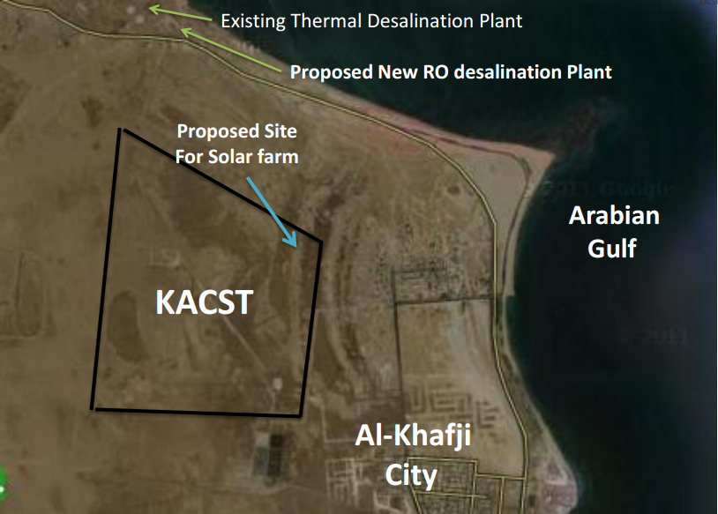
Case Study: Solar Water Desalination in Al-KHafji, Saudi Arabia
Announced in early 2010 and the first plant in Al-Hafji is currently under construction
Plant utilizes a Ultra High Concentrator Photovoltaic (UHCPV) system
Three phase plan
  Phase I: Construction of solar-powered desalination plant at Khafji (30,000,000 l/day)
  Phase II: Construction of a second solar-powered desalination plant (3,000,000,000 l/day)
  Phase III: Construction of additional solar-powered desalination plants across Saudi Arabi
All three phases are projected to be completed by 2020

Slide 50
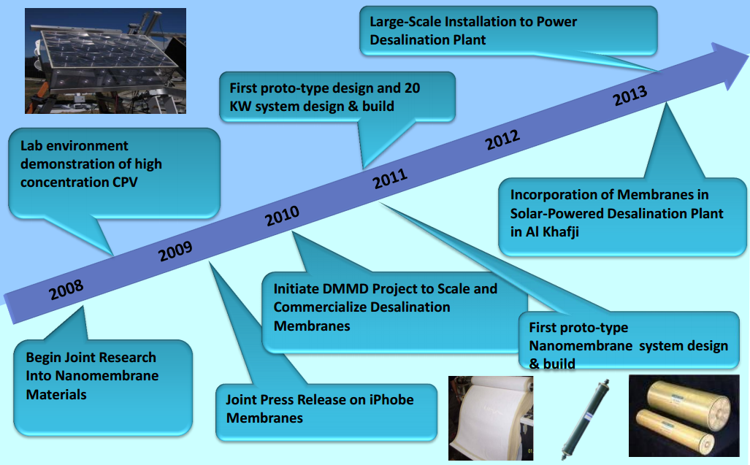
Case Study: timeline of Al-khafji Solar Project
Current Timeline of Al-Khafji Solar Project

Slide 51
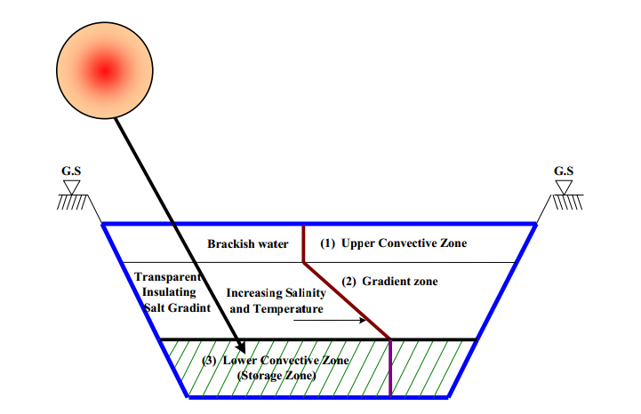
Solar Ponds
Solar energy from the sun is absorbed by saltwater causing the pond to heat off
Ambient air causes the top layer of water to cool off causing convective circulation (war water rises from the bottom and cooler water sinks from the top)
A solar pond is designed in a way so that the top layer is less dense and therefore less saline while the bottom layer is more dense and therefore more saline
  This design inhibits convective circulation enabling thermal energy to be stored in the bottom layer of the pond
Thermal energy can be extracted by piping the bottom layer through a heat exchanger
Solar Pond

Slide 52
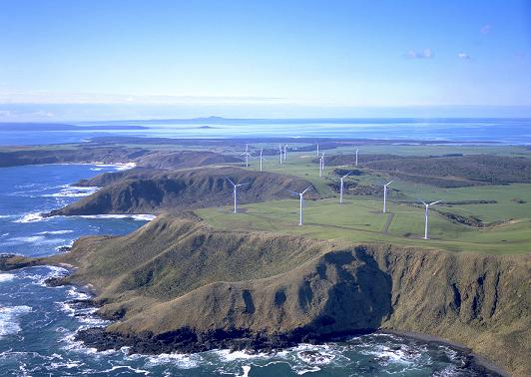
Wind Power Desalination
Wind Powered Desalination is highly applicable to locations with ample wind energy resources such as islands
Wind energy could be used to power seawater desalination for fresh water production
Wind turbines could either be connected in a grid system which provides power to a desalination system or individual wind turbines could be coupled directly to a desalination system
With either system power variations could occur due to wind fluctuations. These power variations would decrease the performance of desalination equipment and possibly reduce the life cycle of specific components
  Back up energy systems would be required to put in place to be used in times when no wind is present

Slide 53

Case Study: Wind Powered Desalination Perth, Australia Emu Downs Wind Farm
Location: North of Perth, Australia in Cervantes
The Emu Downs wind farm power for the Kwinana desalination plant in Perth.
Capital Cost: $170 Million
Wind Farm Capacity: 80 MW
Power Production: 270 GWh/year (180 GWh/year used by Kwinana desalination plant)
Greenhouse Gas Savings: 280,000 tonnes/year
Number of Turbines: 48 Vestas wind turbine
Turbine Height: 68.5m
Blade Length: 41m
Blade Rotational Speed: 14.4 m/s
Emu Downs Wind Farm

Slide 54

Case Study: Wind powered Desalination PERTH, Australia Kwinana Desalination PLant
The Kwinana Desalination plant uses reverse osmosis process and electricity for the plant is provided by the Emu Downs Wind Farm
Fresh Water Production: 140,000,000 Liters/Day
Energy Usage: 180 GWh/year
Capital Cost: $298 Million
Kwinana Seawater Desalination Plant during its construction

Slide 55

Geothermal Desalination
The use of geothermal energy in desalination is still in the process of being developed
Geothermal energy is energy that is already generated and stored in the earth
Geothermal energy is the 3rd largest renewable resource currently utilized
The energy can be can be used directly as heat or converted in to electricity making it applicable for most desalination process (MED, MSF, MD, VS, RO, FO, EDR)
Geothermal energy production is considerably more stable than other renewable energy sources such as solar and wind power
Geothermal power could be directly used for steam power in thermal desalination plants

Slide 56

cAse Study: Geothermal Desalination, Milos Greece
Geothermal desalination unit to produce 80 m3/hr of fresh water
Hot water from geothermal wells was used to run a 470 kWe power generator unit
The generator unit powered a multiple-effect distillation (MED) process in order to produce fresh water
Notes:
use case study and then

Slide 57

Wave Power Desalination
Wave powered energy production technologies are still in a research and development phase
Energy can be harvested in the ocean via underwater currents, waves, and the tide
Current research has been primarily focused on electricity production so wave power could help power RO treatment facilities
Notes:
Look for field studies, add two pass nano filtration

Slide 58

Case Study: Wave-power Desalination, Garden Island, Australia
Capital Cost: 1.17 Million
Operational as of April 2014
Fresh water production capacity: 150 m3/day
3 submerged CETO units that rise and fall with the waves causing a pump to expand and contract
The CETO units provide electricity into the grid while also providing power for desalination

Slide 59
Please note that more materials will be added in the near future.

Slide 60
References
[1] http://www.sciencedirect.com/science/article/pii/S0011916407006005
[2] https://www.esmap.org/sites/esmap.org/files/DocumentLibrary/ESMAP-MENA_CSP-ReadMoreLink.pdf
[3] http://www.desertec.org/downloads/aqua-csp_en.pdf
[4] http://wle.cgiar.org/blogs/2013/05/23/desalination-using-renewable-energy-is-it-the-answer-to-water-scarcity/
[5] http://www.prb.org/Publications/Reports/2002/FindingtheBalancePopulationandWaterScarcityintheMiddleEastandNorthAfrica.aspx
[6] http://www.waterworld.com/articles/wwi/print/volume-28/issue-3/regional-spotlight-latin-america/solar-powered-water-desalination-heats.html
[7] http://www.energyeducation.tx.gov/renewables/section_3/topics/solar_ponds/img/fig6-saltpond.png
[8]http://www.eolss.net/sample-chapters/c08/e6-106-30.pdf
[9] http://www.eng.nus.edu.sg/EResnews/0910/sf/sf8.html
[10] http://sine.ni.com/cms/images/casestudies/iisca.jpg?size
[11] http://kacstwatertech.org/eng/presentatoins/Day1/Session_1_1/Turki.pdf
[12] http://www.erec.org/fileadmin/erec_docs/Projcet_Documents/K4_RES-H/K4RES-H_Geothermal_desalination.pdf
[13] http://www.geoelec.eu/wp-content/uploads/2012/01/7.-Geothermal-prospects-of-Milos-Nisyros-Lesvos-Methana-Spyridonos.pdf
[14] http://egec.info/wp-content/uploads/2011/03/Brochure-DESALINATION1.pdf

Slide 61
References
[15] http://www.water-technology.net/projects/perth/
[16] http://www.apa.com.au/media/208711/edwf%20-%20web%20page2%20feb13.pdf
[17] http://www.farmertronics.com/actueel/renewable-energy/
[18] http://www.solar-power-made-affordable.com/types-of-renewable-energy.html
[19] http://www.npr.org/templates/story/story.php?storyId=11134967
[20] http://www.geni.org/globalenergy/library/articles-renewable-energy-transmission/small-island-nations.shtml
[21] http://assets.conferencespot.org/fileserver/file/34194/filename/a380_1.pdf
[22] http://www.waterworld.com/articles/wwi/print/volume-28/issue-6/regional-spotlight-asia-pacific/wave-powered-desalination-riding-high-in-australia.html
[23] https://s-media-cache-ak0.pinimg.com/736x/c3/86/94/c38694e1a5181182559dba4d6d42306d.jpg
[24] http://www.erec.org/fileadmin/erec_docs/Projcet_Documents/K4_RES-H/K4RES-H_Geothermal_desalination.pdf

Slide 62
References
[25] Understanding Solar Stills – Horace McCracken, Joel Gordes, VITA 1985
[26] Fresh Water From the Sun – Daniel C. Dunham, Office of Health, Development Support Bureau, U.S. Agency for International Development, 1978
[27] How to Find Water in the Wild – http://www.abovetopsecret.com/forum/thread933281/pg1
[28] http://inhabitat.com/6-water-purifying-devices-for-clean-drinking-water-in-the-developing-world/
[29] http://www.gizmag.com/desalination-water-chip/28172/
[30] http://stateimpact.npr.org/texas/2013/07/31/is-this-chip-the-key-to-desalination/
[31] https://www.irena.org/DocumentDownloads/Publications/IRENA-ETSAP%20Tech%20Brief%20I12%20Water-Desalination.pdf
[32] http://www.plosone.org/article/info%3Adoi%2F10.1371%2Fjournal.pone.0089934
[33] http://www.technologyreview.com/view/524606/new-desalination-technique-also-cleans-and-disinfects-water/
[34] http://static.panoramio.com/photos/large/18943324.jpg
[35]

